Slide 1

Image-to-Image Translation with Generative Adversarial Networks
Guided by,
Prof. Dinesh Naik
Presented by,
222IT018 - Pankaj Kumar Magar
222IT034 - Vedant Parwal
1

Slide 2
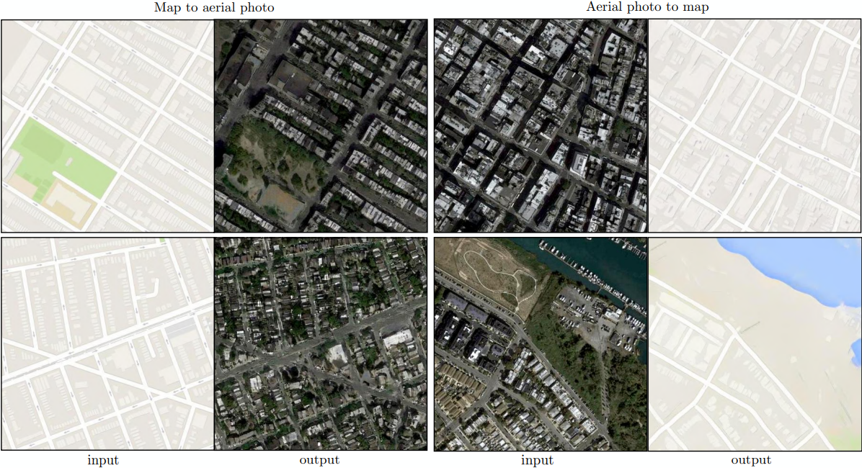
Overview
GANs are generative models: they create new data instances that resemble your training data.

Slide 3
Dataset Details
The dataset containing satellite image of cities obtained via web scraping from Google Maps was available publicly provided by UC Berkeley’s Electrical and Computer Science Dept. The data is available as a concatenated form of satellite and map images.
Number images in dataset (train + validation): 2194
Size of each combined image (the satellite and the map image) in dataset is 1200 x 600 which means each image (map or satellite image) is of size 600 x 600.
Size of complete dataset: 257.7 MB

Slide 4
Methodology
The GAN model architecture involves two sub-models:
Generator. Model that is used to generate new plausible examples from the problem domain.
Discriminator. Model that is used to classify examples as real (from the domain) or fake (generated).

Slide 5
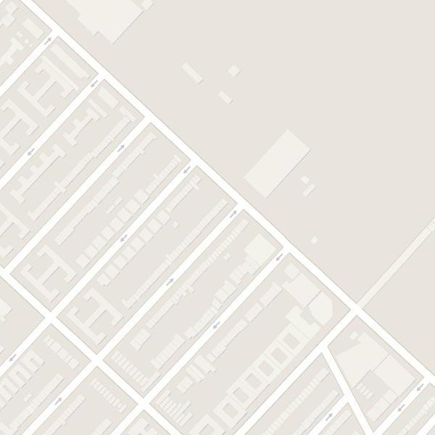
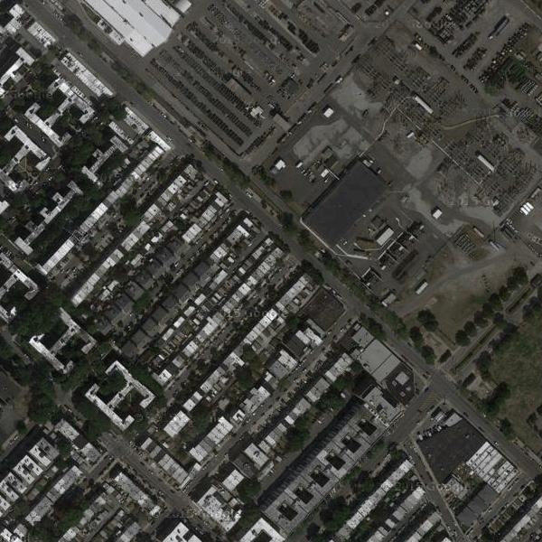
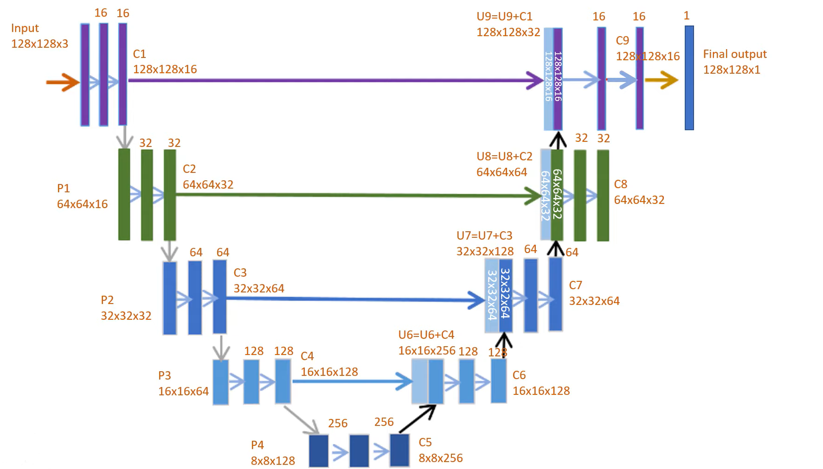
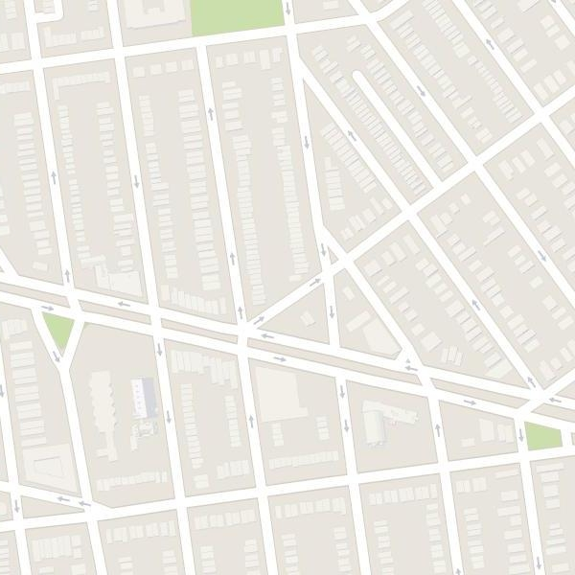
Image to Image translation
Discriminator takes pair of input image and target image
Both image will be concatenated
Generate fake target image using a real image input
Real input to discriminator
Discriminator Loss
Real B
Real A
Real
+
Y
X
Discriminator
Real A
50/50
Generator
Fake B
Real A
Is the target image a
real or fake ?
+
Fake
Generator
Loss
Y
X
Fake input to discriminator
L1 vs GAN loss are weighted 100 to 1
L1(MAE) loss
Minimize loss between real and generated target image
GAN loss (Binary cross entropy)
5

Slide 6

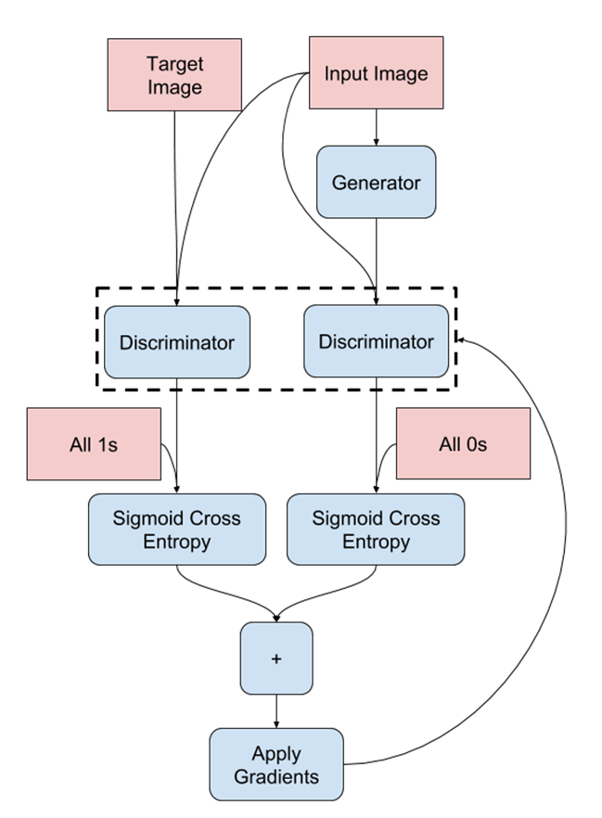
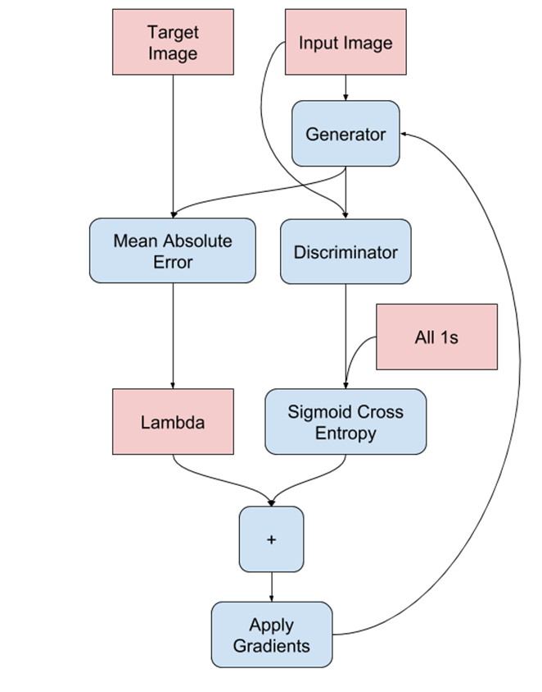
Generator – Discriminator
Generator
Discriminator

Slide 7
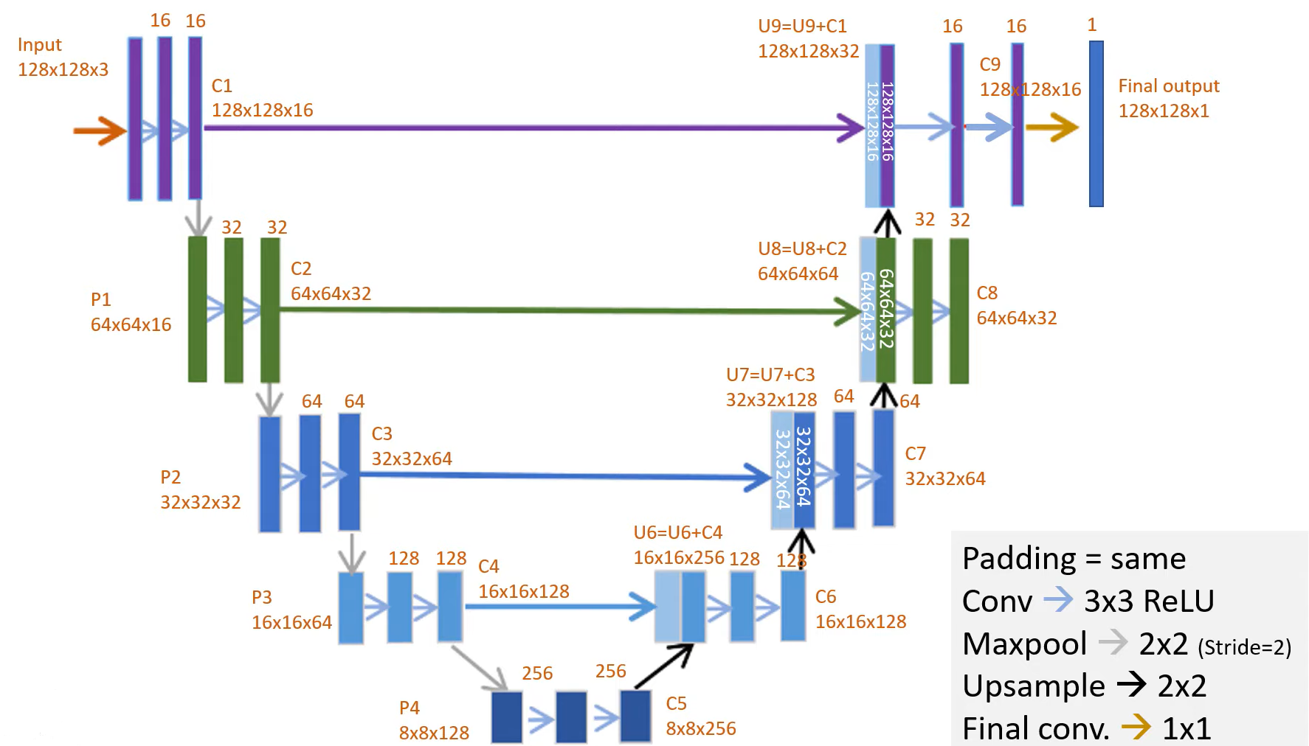
U-Net
U-Net Architecture

Slide 8
Condition GAN is suitable for image to image translation tasks, where we condition on an input image and generate a corresponding output image.
For our generator we use a “U-Net” based architecture and for our discriminator we use a Convolutional “PatchGAN” classifier.
We alternate between one gradient descent step on D then one step on G.
Batch size is set to 1. Has been demonstrated to be effective at image generation tasks.
The 70*70 PatchGAN forces outputs that are shaped.

Slide 9
Generator architectures:
Encoder :
C64-C128-C256-C512-C512-C512-C512-C512
Decoder :
CD512-CD512-CD512-CD512-CD256-C128-C64
Where,
D = Convolutional Dropout
Generator architectures:
The 70*70 discriminator architectures is:
C64-C128-C256-C512
All ReLUs are leaky, with slope 0.2.

Slide 10
Discriminator architectures (PatchGAN):
The discriminator in the GAN’s is implemented as a PatchGAN.
PatchGAN discriminator tries to classify if each N*N patch in an image is real or fake (as opposed to classifying an entire image)
This discriminator is run convolutionally across the image averaging all responses to provide the final output.
The respective field in a PatchGAN represents the relationships between one output activation to an area on the input image.
A 70*70 PatchGAN will classify 70*70 patches of the input image as real or fake.

Slide 11
Modifications
Initially we were converting satellite images to map routes. Here we modified our architecture to convert both ways, that is from satellite to map routes as well as from map routes to satellite images.
If we don't have same satellite image and map image corresponding to satellite image this is where unpaired image to image translation comes into picture using GAN.
For many tasks, paired training data will not be available .
Capturing special characteristics of one image collection and figuring out how these characteristics could be translated into the other image collection, all in the absence of any paired training examples.
We use instance normalization. It standardizes values on each output layer map rather than across features in a batch.

Slide 12
Generator Architecture : The network with 6 residual blocks consists of
C7S1-64, D128, D256, R256, R256, R256, R256, R256, R256, U128, U64,
C7S1-3
Where, D = 3 x 3 convolution-InstanceNormalization-ReLU
R = Residual block that contains two 3 x 3 convolutional layers
U = 3 x 3 fractional-strided-convolution-InstanceNorm-ReLU
Discriminator Architecture :
70*70 Patch GAN C64-C128-C256-C512
Model has 2 generators and 2 discriminators.
Discriminator is a 70*70 PatchGAN, like the one used in before. Except here we use instance normalization.
Discriminator is trained directly on generated (fake) and real images

Slide 13
The model contains two generator models:
Generator A : Generates images for the first domain (e.g Satellite).
Generator B : Generates images for the second domain (e.g Maps routes).
Inputs to generators comes from the other domain :
Satellite → Generator A → Map routes
Maps route → Generator B → Satellite
Each generator has a corresponding discriminator model (Discriminator A and Discriminator B)
Map routes → Discriminator A → Real/Fake.
Satellite → Generator A (Generates Map routes) → Discriminator A → Real/Fake
Satellite → Discriminator B → Real/Fake
Map routes → Generator B(Generates Satellite)→ Discriminator B → Real/fake

Slide 14
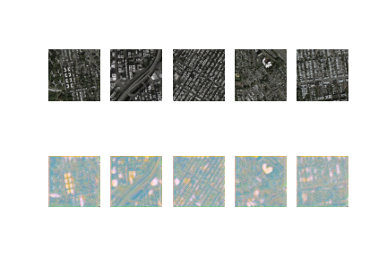
Results
Satellite to Maps route trained for 20 epochs

Slide 15
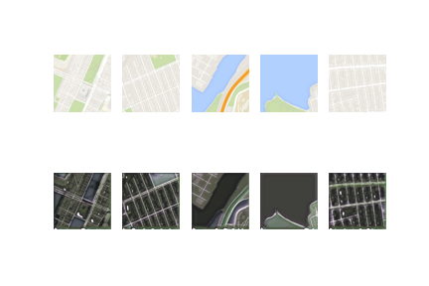
Maps to Satellite route trained for 20 epochs

Slide 16
Thank You

